Slide 1
Data Flow Architectures
Basics
  Execution is driven only by the availability of operands at the inputs to the functional units.
  Parallelism is dependent on the actual data dependences in the program.
  Dataflow architectures use dataflow graphs as their machine languages.
Limitations of the dataflow architecture
  Performance restricted by the number of functional units, limited memory bandwidth & the need to associatively match pending operations with available functional units.

Slide 2
Dataflow Model of Computing
Enabling rule:
  An instruction is enabled (executed) if all operands are available.
  Von Neumann model: an instruction is enabled if it is pointed to by PC.
The computational rule or firing rule, specifies when an enabled instruction is actually executed.
Basic instruction firing rule:
  An instruction is fired (i.e. executed) when it becomes enabled.
  The effect of firing an instruction is the consumption of its input data (operands) and generation of output data (results).
During the execution of the program, data propagate along the arcs in data packets, called tokens.
This flow of tokens enables some of the nodes (instructions) and fires them.

Slide 3
Dataflow Architectures
Pure dataflow computers:
  static,
  dynamic,
  and the explicit token store architecture.
Hybrid dataflow computers:
  Augmenting the dataflow computation model with control-flow mechanisms, such as
    RISC approach,
    complex machine operations,
    multi-threading,
    large-grain computation,
    etc.

Slide 4
Pure Dataflow
A dataflow computer executes a program by receiving, processing and sending out tokens, each containing some data and a tag.
Dependences between instructions are translated into tag matching and tag transformation.
Processing starts when a set of matched tokens arrives at the execution unit.
The instruction which has to be fetched from the instruction store (according to the tag information) contains information about
  what to do with data
  and how to transform the tags.
The matching unit and the execution unit are connected by an asynchronous pipeline, with queues added between the stages.
Some form of associative memory is required to support token matching.
  a real memory with associative access,
  a simulated memory based on hashing,
  or a direct matched memory.

Slide 5
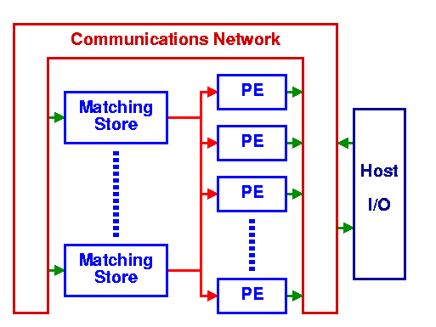
Dataflow Architecture

Slide 6
Dataflow Languages
Main characteristic: The single-assignment rule
  A variable may appear on the left side of an assignment only once within the area of the program in which it is active.
Examples: VAL, Id, LUCID
A dataflow program is compiled into a dataflow graph which is a directed graph consisting of named nodes, which represent instructions, and arcs, which represent data dependences among instructions.
  The dataflow graph is similar to a dependence graph used in intermediate representations of compilers.

Slide 7
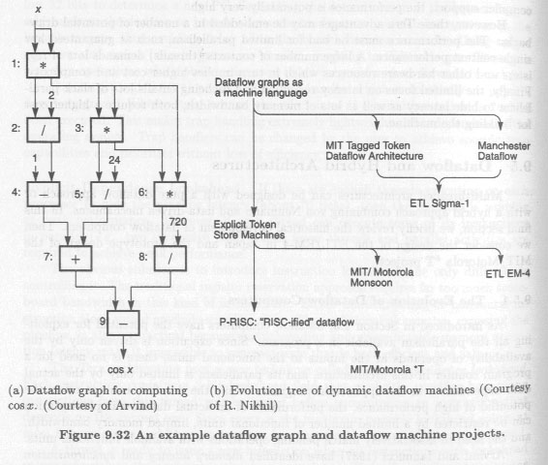
Dataflow Graph

Slide 8
Static Dataflow
A dataflow graph is represented as a collection of activity templates,
each containing:
  the opcode of the represented instruction,
  operand slots for holding operand values,
  and destination address fields, referring to the operand slots in sub-sequent activity templates that need to receive the result value.
Each token consists only of a value and a destination address.

Slide 9
Dynamic Dataflow
Each loop iteration or subprogram invocation should be able to execute in parallel as a separate instance of a reentrant subgraph.
The replication is only conceptual.
Each token has a tag:
  address of the instruction for which the particular data value is destined
  and context information
Each arc can be viewed as a bag that may contain an arbitrary number of tokens with different tags.
The enabling and firing rule is now:
  A node is enabled and fired as soon as tokens with identical tags are present on all input arcs.

Slide 10
Pros and Cons of Dynamic Dataflow
Major advantage: better performance (compared with static) because it allows multiple tokens on each arc thereby unfolding more parallelism.
Problems:
  efficient implementation of the matching unit that collects tokens with matching tags.
    Associative memory would be ideal.
    Unfortunately, it is not cost-effective since the amount of memory needed to store tokens waiting for a match tends to be very large.
    All existing machines use some form of hashing techniques.
  bad single thread performance (when not enough workload is present)
  dyadic instructions lead to pipeline bubbles when first operand tokens arrive
  no instruction locality → no use of registers

